Slide 1

Constraint Satisfaction Problems
AIFA (AI61005) 2021 Autumn
Plaban Kumar Bhowmick

Slide 2
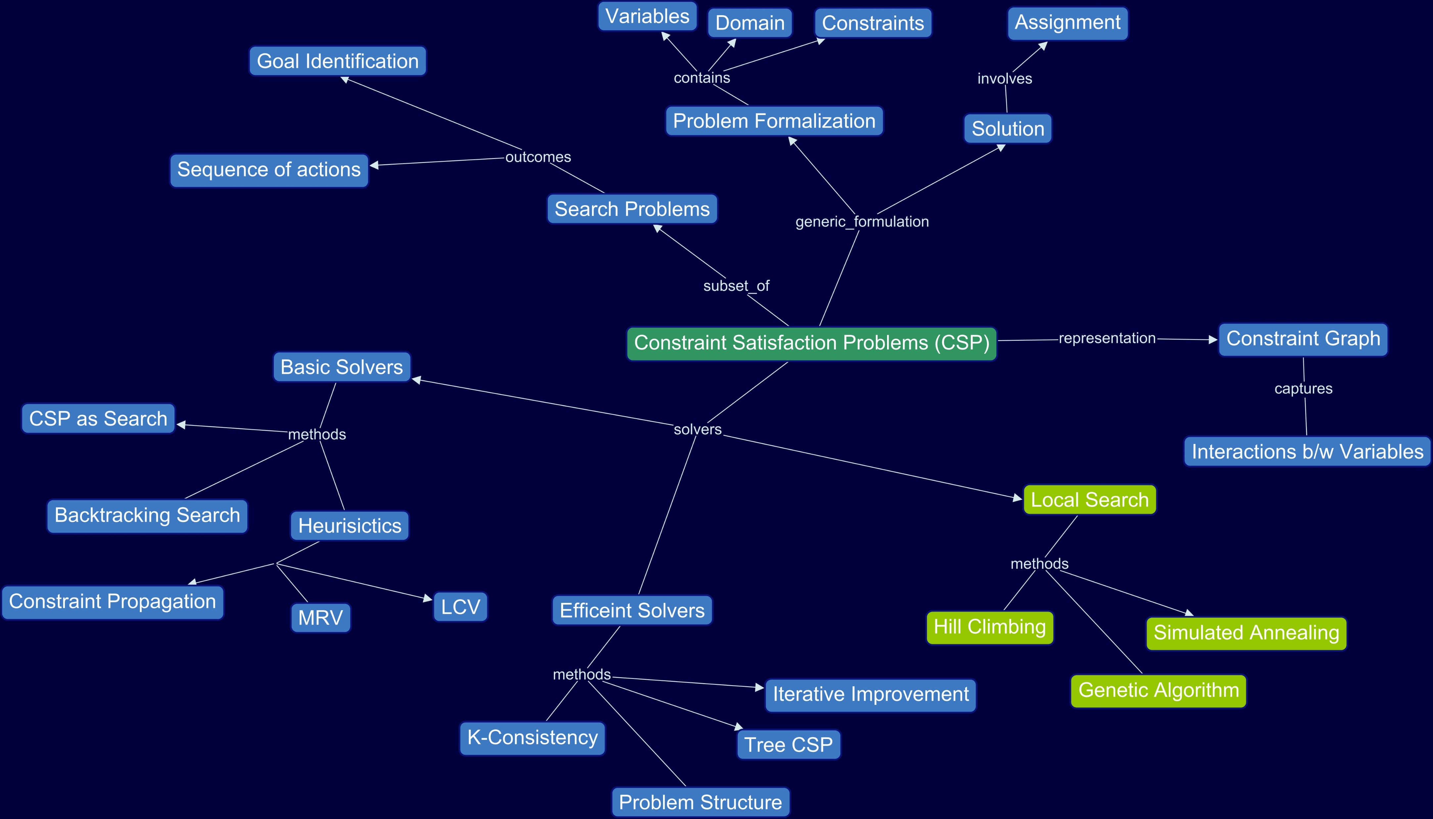

Slide 3
CSP: Why and What

Slide 4

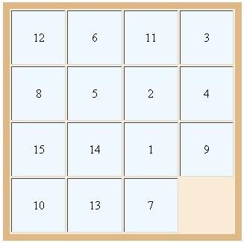
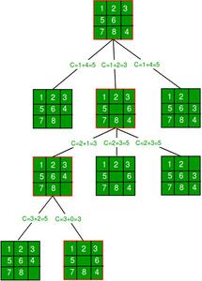

AI Problem Solvers: Evolution
def solve(puzzle puzz):
…………………………………
…………………………………
move(c1, c2)
check(solution)
…………………………………
…………………………………
def solve(puzzle puzz):
…………………………………
…………………………………
puzzle.isGoal()
return true
succ = puzz.successor()
…………………………………
…………………………………
Brute-Force Approach
Search Algorithms

Slide 5

AI Problem Solvers: Evolution
def solve(puzzle puzz):
…………………………………
…………………………………
puzzle.isGoal()
return true
succ = puzz.successor()
…………………………………
…………………………………
Can we have Truly Generic Problem Solvers?
YES. But for specific class of problems
Constraint Satisfaction Problems
What are the implications?
Search Algorithms
Make isGoal and successor problem agnostic
Overall structure: Problem Agnostic
Design methods and heuristics: Problem Agnostic
Still isGoal and successor are problem specific

Slide 6
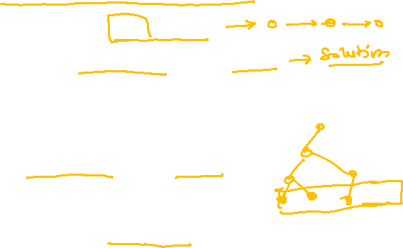
Revisiting Search Problems
The world
Single agent, deterministic action, fully observable, discrete state
Planning a sequence of actions
Important: Path to goal
Paths: varying costs and depths
Heuristics to reduce search space
Identification of goal
Goal is important not path
All paths are at same depth
CSPs are identification problems

Slide 7
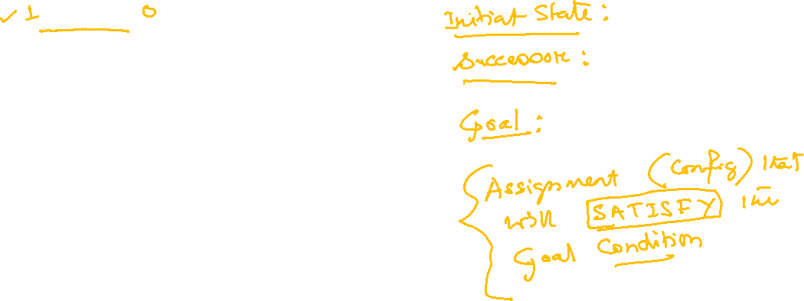
Let us Solve
2
1
5
1
3
5
4
1
5
7
5
4
2
2
4
1

Slide 8
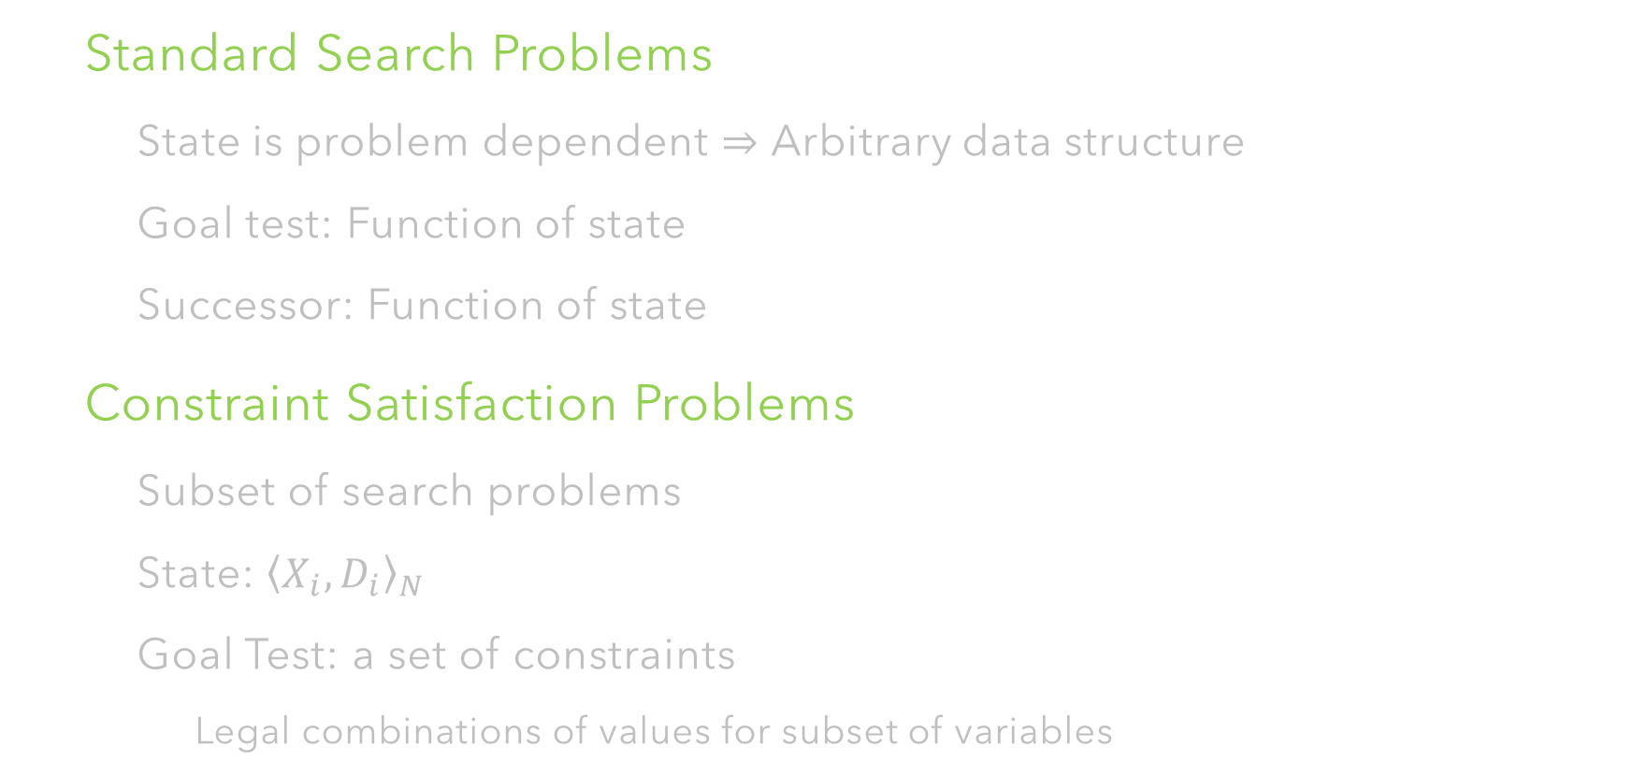
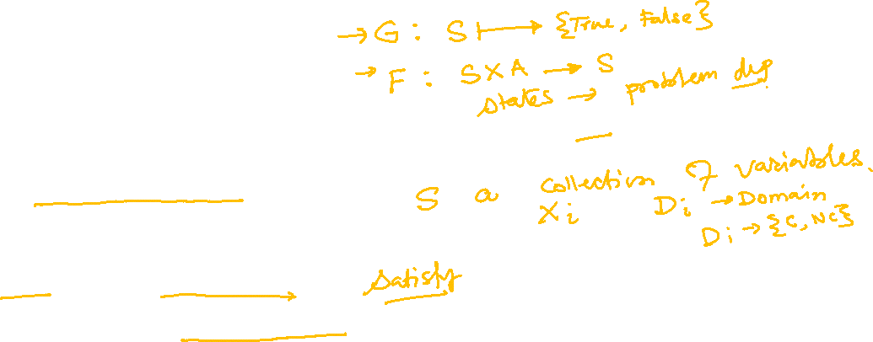
Constraint Satisfaction Problems
Standard Search Problems
State is problem dependent $⇒$ Arbitrary data structure
Goal test: Function of state
Successor: Function of state
Constraint Satisfaction Problems
Subset of search problems
State: ${\left\langle X_{i},D_{i}\right\rangle }_{N}$
Goal Test: a set of constraints
Legal combinations of values for subset of variables

Slide 9
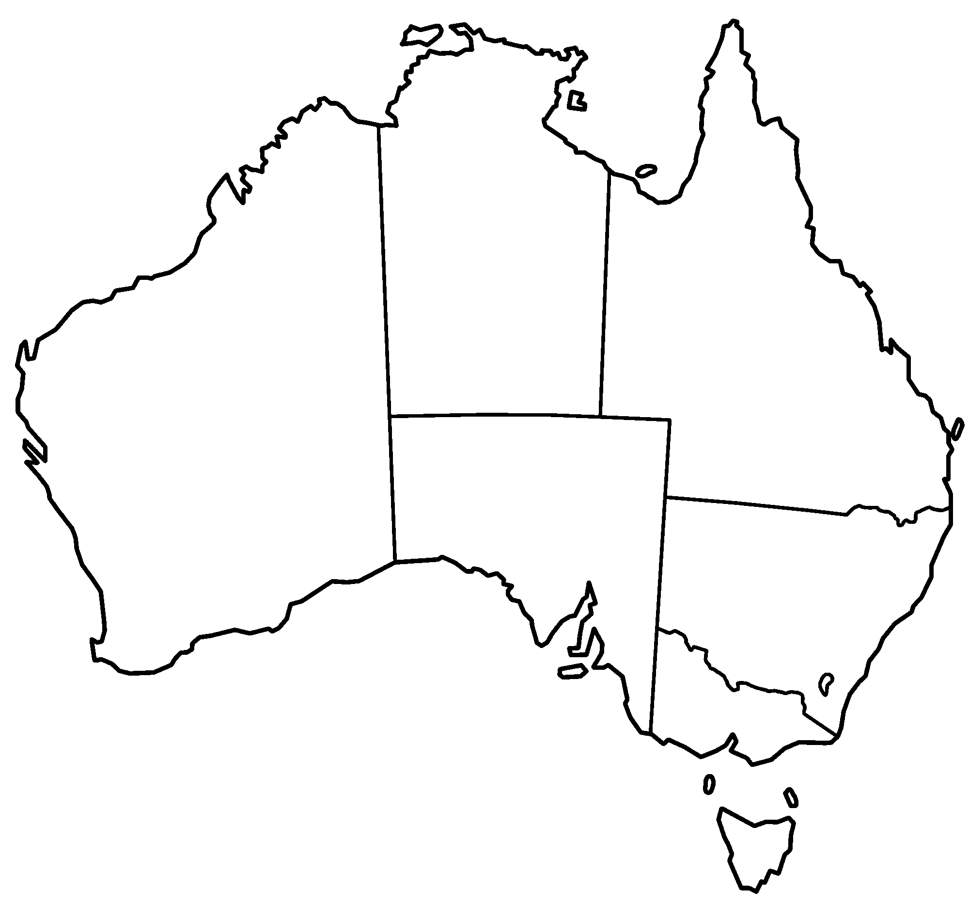

Constraint Satisfaction Problems
Northern Territory
Queensland
Western Australia
South Australia
New South Wales
Victoria
Tasmania
Map Coloring Problem

Slide 10
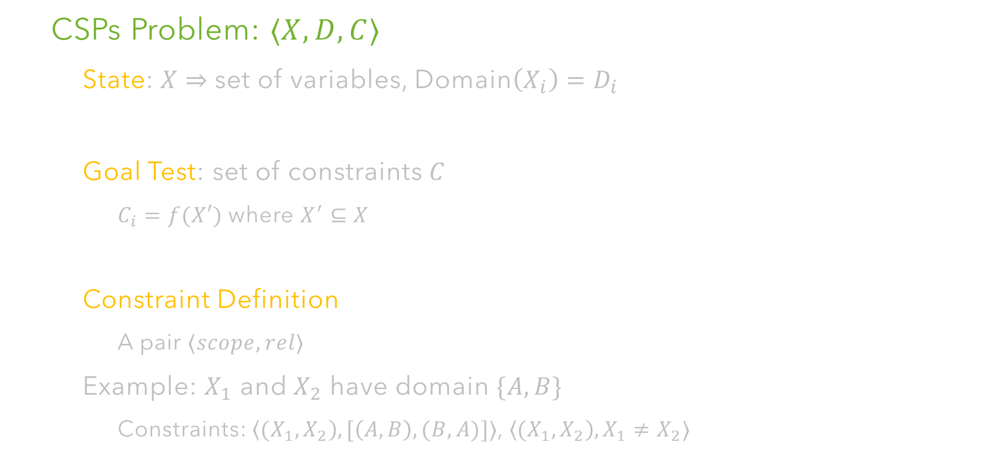
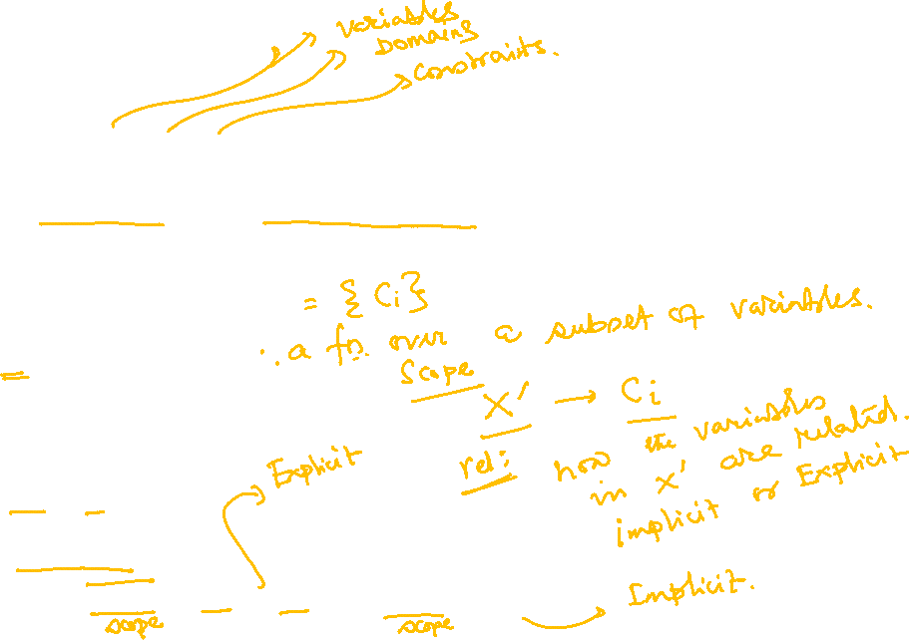
CSPs: Formulation
CSPs Problem: $⟨X,D,C⟩$
State: $X⇒$set of variables, Domain$\left(X_{i}\right)=D_{i}$
Goal Test: set of constraints $C$
$C_{i}=f(X′)$ where $X^{′}⊆X$
Constraint Definition
A pair $⟨scope, rel⟩$
Example: $X_{1}$ and $X_{2}$ have domain $\{A,B\}$
Constraints: $\left\langle {(X}_{1}, X_{2}\right), [\left(A,B\right), (B,A)]⟩$, $\left\langle {(X}_{1}, X_{2}\right), X_{1}≠X_{2}⟩$

Slide 11
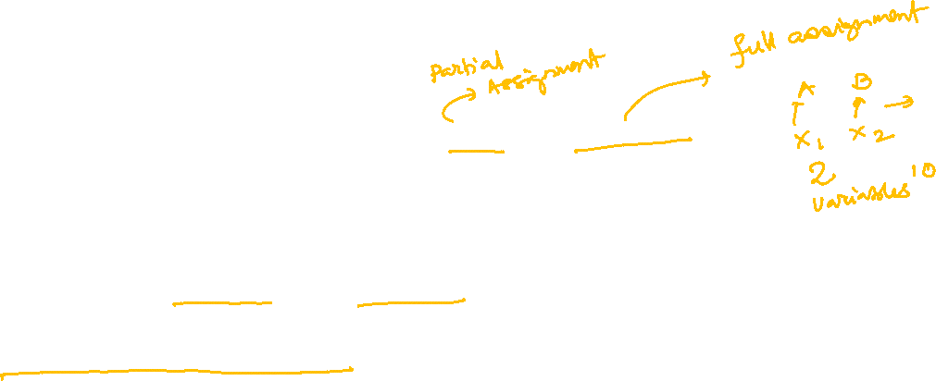
CSPs: Formulation
Solution
Assignment: Assigning values to some or all variables
Consistent Assignment: Does not violate any constraint
Complete Assignment: Every variable is assigned a value
Solution: Consistent and Complete Assignment
General purpose algorithms with more power than standard search algorithms

Slide 12
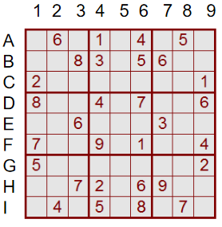
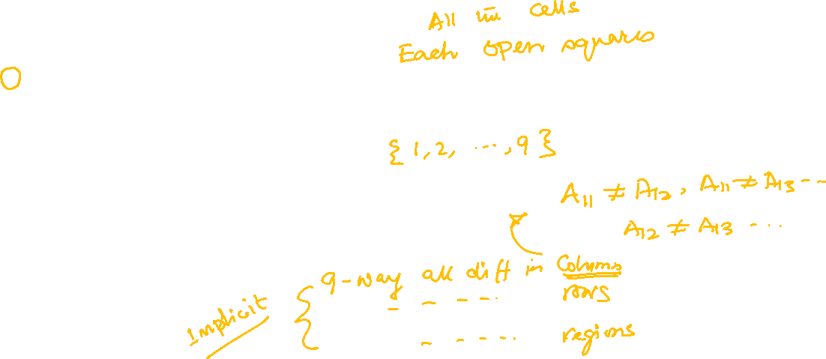
CSP Example: Sudoku
Variables:
Domain:
Constraint:

Slide 13
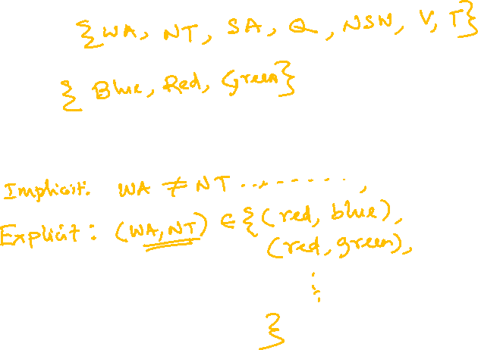
CSP Example: Map Coloring
Variables:
Northern Territory
Domain:
Queensland
Western Australia
South Australia
Constraint:
New South Wales
Solution:
Victoria
Tasmania

Slide 14
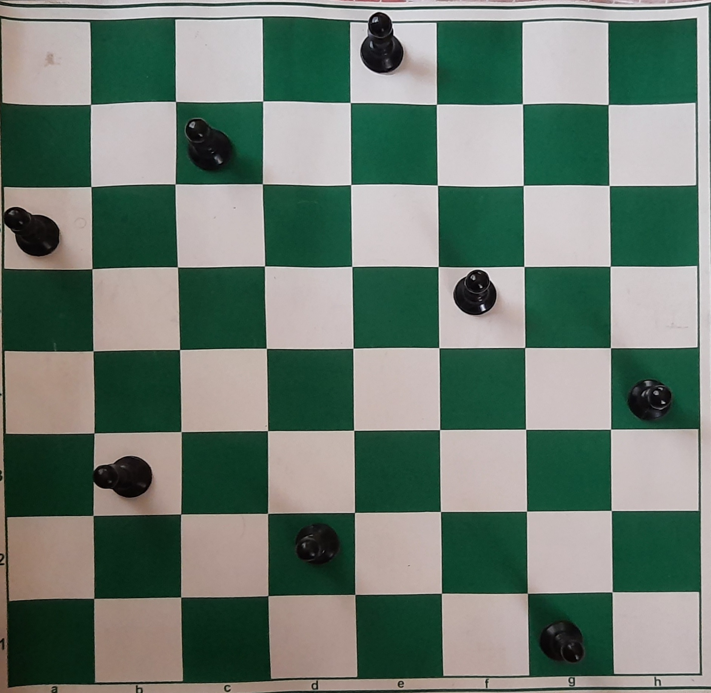
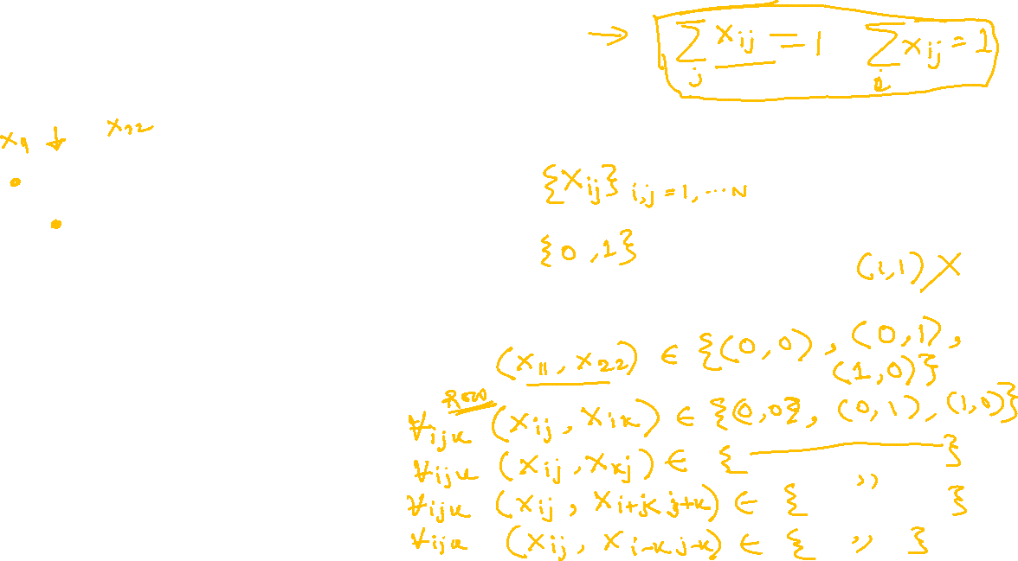
CSP Example: N-Queens
Formulation - 1
Variables:
Domain:
Constraint:

Slide 15
CSP Example: N-Queens
Formulation - 2
Variables:
Domain:
Constraint:

Slide 16

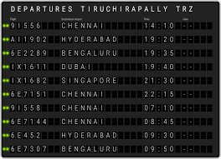
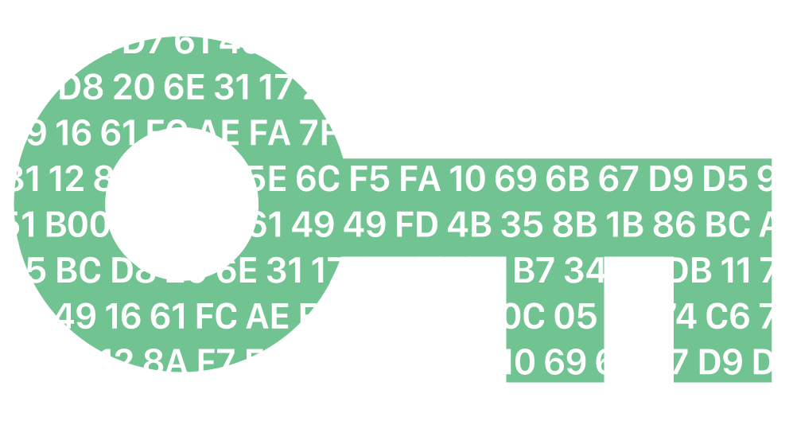
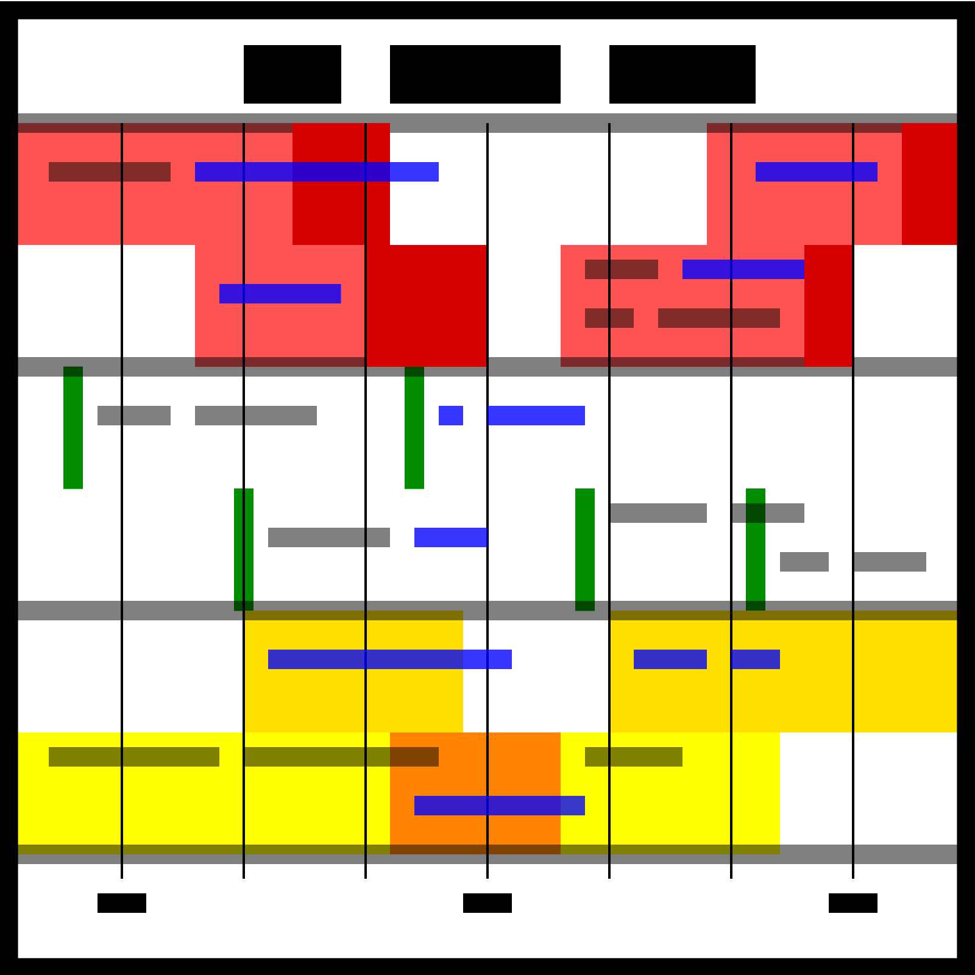
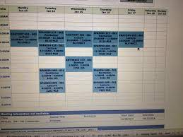
Example Applications

Slide 17
Map Coloring to Graph Coloring
More general problem than graph coloring
Planar Graph = Graph drawn on 2D plane without edges crossing
“Every planar graph can be colored with 4 or less” –
Guthrie (1852)
Was proven in 1977 – Appel and Haken

Slide 18

Graphs as Abstraction Tool
Binary CSP:
NT
Northern Territory
Q
WA
Queensland
Western Australia
Binary Constraint Graph:
South Australia
SA
NSW
New South Wales
V
Constraint Graph
Victoria
Claim: CSP algorithms with graph to speed up search
T
Tasmania

Slide 19
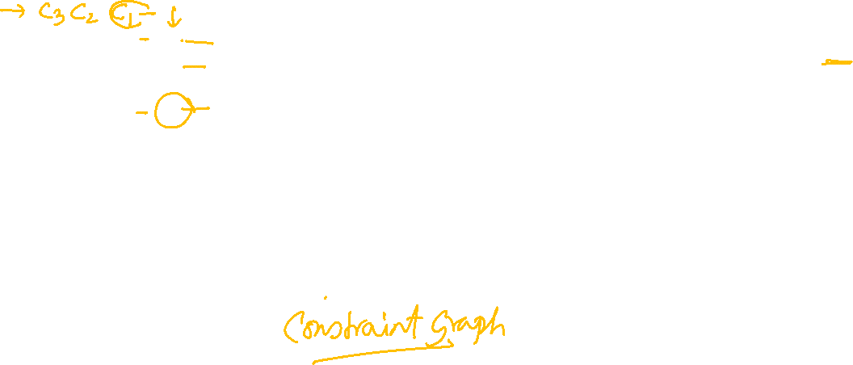
CSP Example: Cryptarithmetic
O
+
T W O
T W O
O+O = R+10*C1
R
C1
C1={0,1}
F O U R
W
W+W+C1 = U+10*C2
Variables =
All Different
C2
U
C2={0,1}
T+T+C2 = O+10*C3
Domain =
T
C3
C3={0,1}
Constraints =
F
C3=F

Slide 20
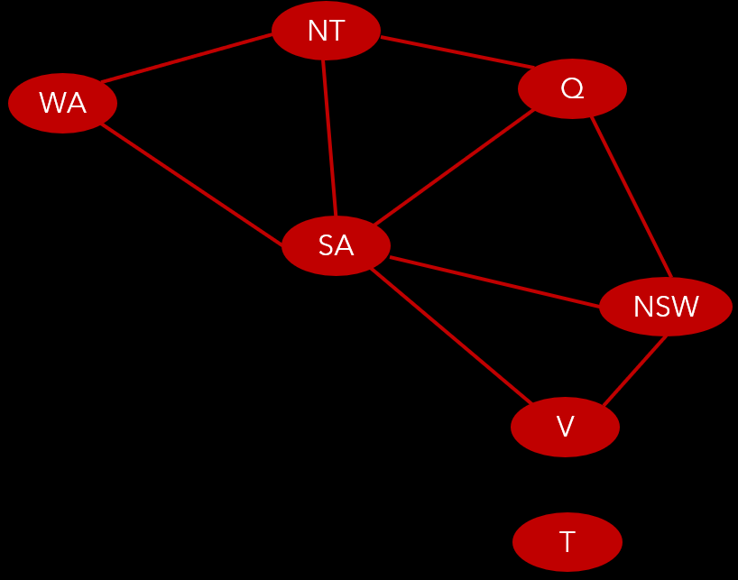
What is the Big Deal?
CSP solver can prune a large region of the search space

Slide 21
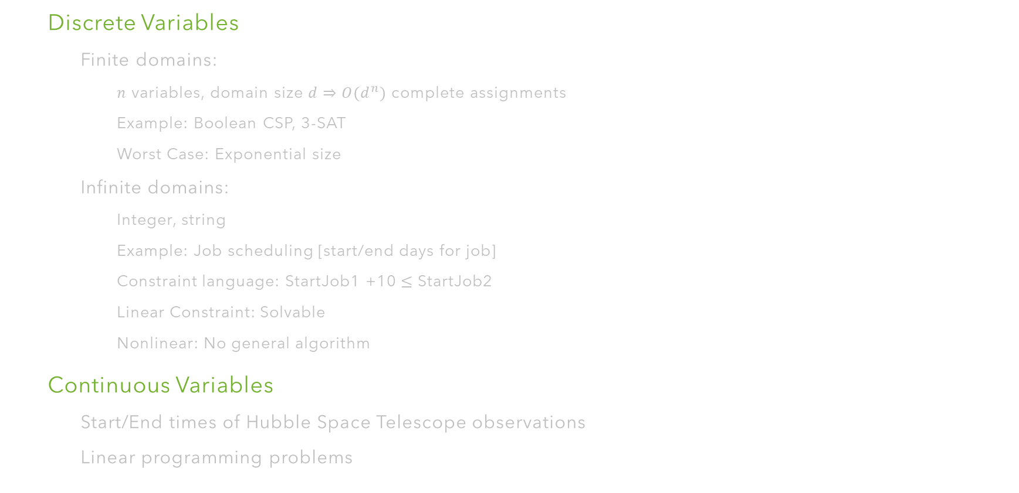

CSP Variations: Variables
Discrete Variables
Finite domains:
$n$ variables, domain size $d⇒O(d^{n})$ complete assignments
Example: Boolean CSP, 3-SAT
Worst Case: Exponential size
Infinite domains:
Integer, string
Example: Job scheduling [start/end days for job]
Constraint language: StartJob1 +10 $≤$ StartJob2
Linear Constraint: Solvable
Nonlinear: No general algorithm
Continuous Variables
Start/End times of Hubble Space Telescope observations
Linear programming problems

Slide 22
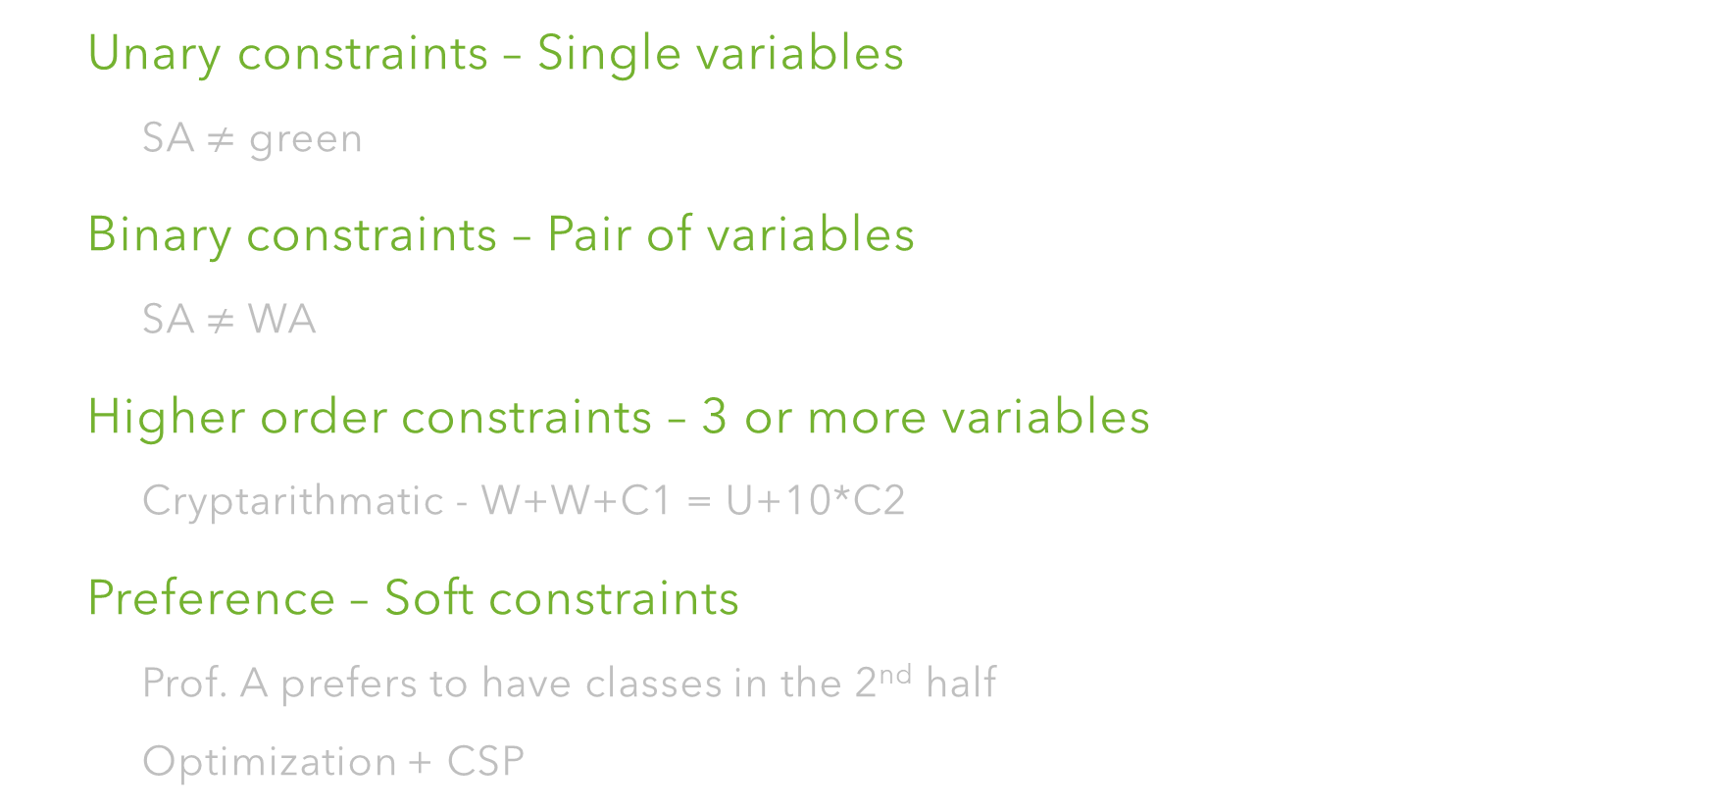
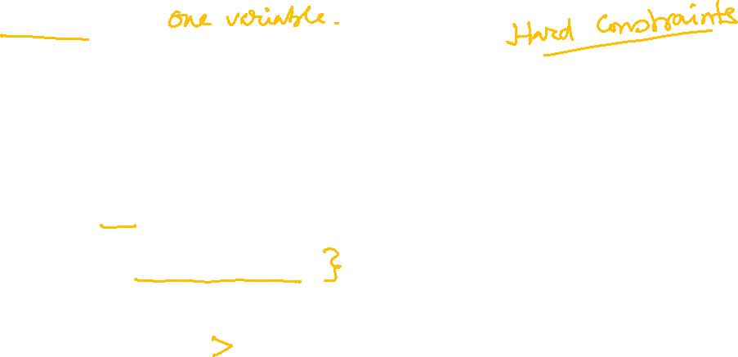
CSP Variations: Constraints
Unary constraints – Single variables
SA $≠$ green
Binary constraints – Pair of variables
SA $≠$ WA
Higher order constraints – 3 or more variables
Cryptarithmatic - W+W+C1 = U+10*C2
Preference – Soft constraints
Prof. A prefers to have classes in the 2nd half
Optimization + CSP

Slide 23
CSP: Basic Solvers

Slide 24


CSP as Search Problem
Incremental formulation
Initial State
Empty assignment {}
Successor Function
Assign a value to any unassigned variable without conflict wrt previously assigned variables
Goal Test
Current assignment complete?
Path Cost
Constant cost for every step
Every solution appears at depth $n$ if there are $n$ variables
Search tree extends upto $n$ depth
Depth first search algorithms for CSP

Slide 25
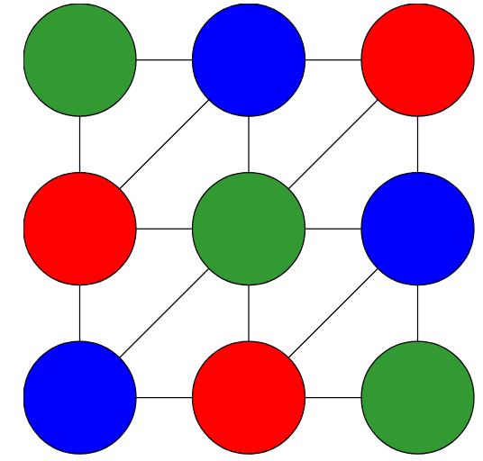
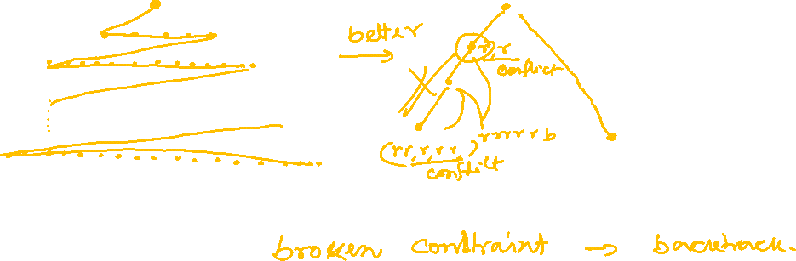
CSP: Search Methods
BFS Strategy
DFS Strategy
Analysis

Slide 26
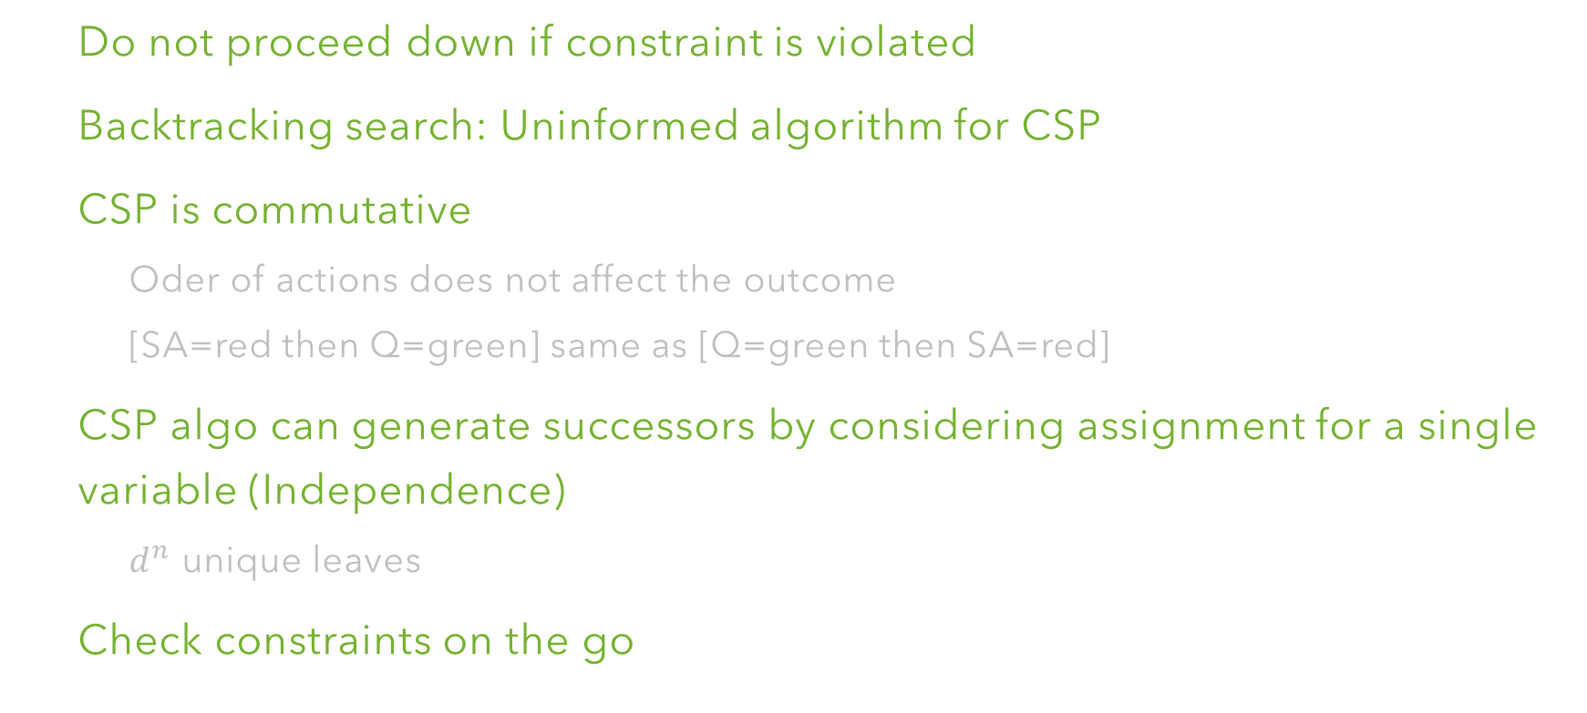
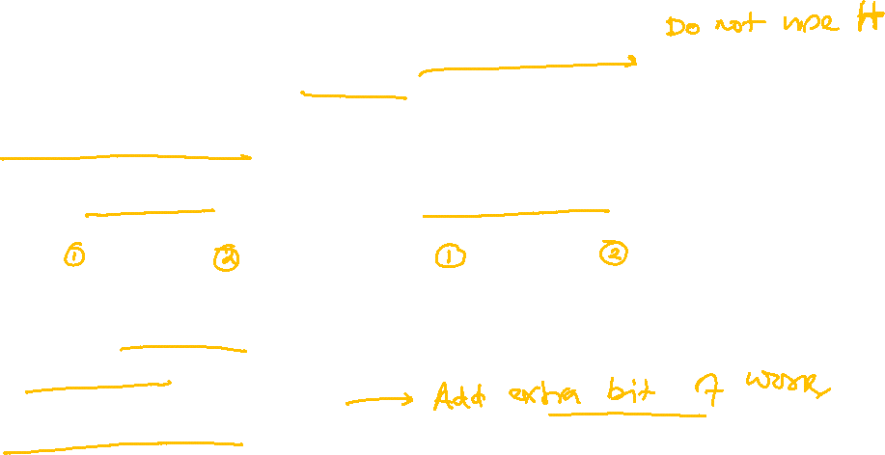
Backtracking Search
Do not proceed down if constraint is violated
Backtracking search: Uninformed algorithm for CSP
CSP is commutative
Oder of actions does not affect the outcome
[SA=red then Q=green] same as [Q=green then SA=red]
CSP algo can generate successors by considering assignment for a single variable (Independence)
$d^{n}$ unique leaves
Check constraints on the go

Slide 27


Backtracking Search
Expand
Pick a single variable to expand
Iterate over domain value
Process one children
One children per value
Backtrack
Conflicting assignment

Slide 28
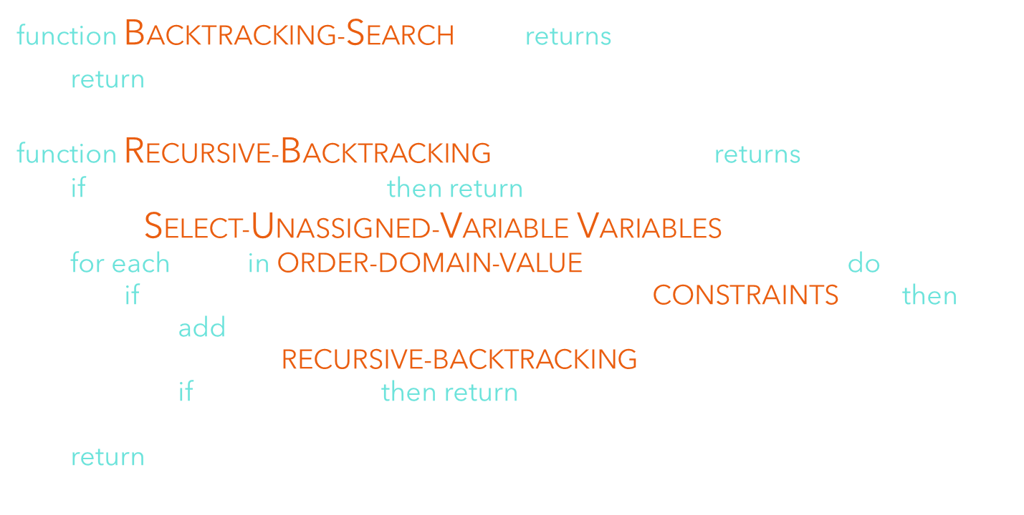

Backtracking Search
function BACKTRACKING-SEARCH (csp) returns solution/failure
return RECURSIVE-BACKTRACKING({ },csp)
function RECURSIVE-BACKTRACKING (assignment, csp) returns sol/fail
if assignment is complete then return assignment
var $←$ SELECT-UNASSIGNED-VARIABLE(VARIABLES[csp], assignment, csp)
for each value in ORDER-DOMAIN-VALUE(var, assignment, csp) do
if value is consistent with assignment given CONSTRAINTS[csp] then
add {var=value} to assignment
result $←$ RECURSIVE-BACKTRACKING(assignment, csp)
if result $≠$ failure then return result
remove {var=value} from assignment
return failure
Backtracking = DFS + variable ordering + fail on conflict

Slide 29
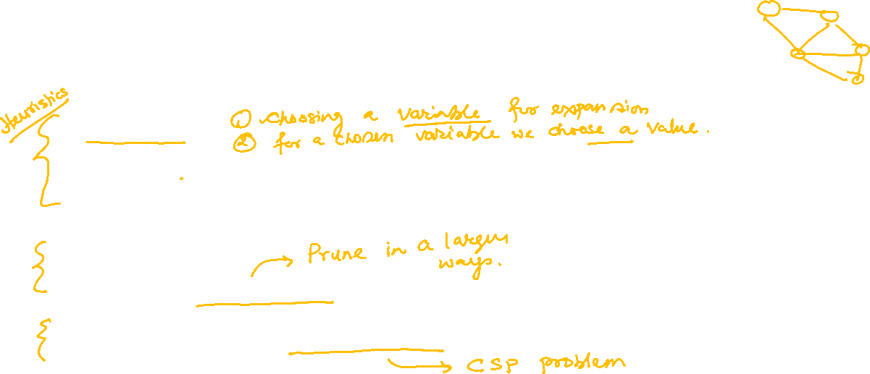
Making Backtracking More Efficient
General uninformed search facilitates huge speed gain
Ordering
Which variable to assigned next?
What would be the order of values?
Filter
Can we detect failures early?
Can we exploit problem structure?
Northern Territory
Queensland
Western Australia
South Australia
New South Wales
Victoria
Tasmania

Slide 30

Backtracking Search: Filtering
Filtering: Take stock of the unassigned variables and filter out the bad options
Forward checking: Cross off values that violate a constraint when added to existing assignment
NT
WA
SA
Q
NSW
V
WA | NT | Q | NSW | V | SA

Slide 31
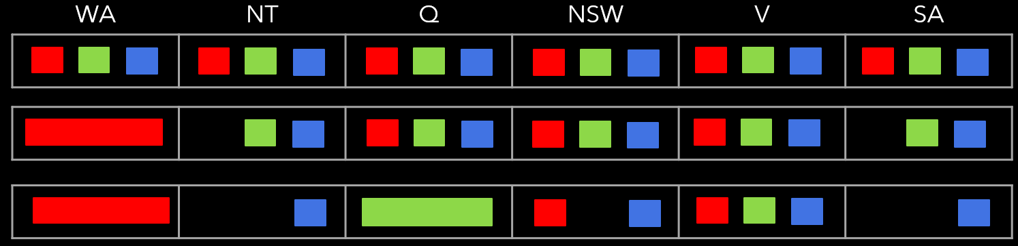

Filtering: Constraint Propagation
NT and SA both must be assigned blue $⇒$ Constraint violation
Can we detect it earlier?
Constraint Propagation: Checking interaction between unassigned variables

Slide 32
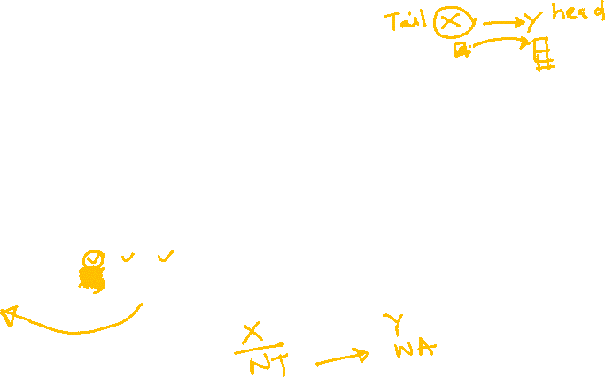
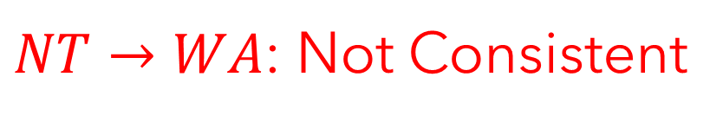
Constraint Propagation: Arc Consistency
An arc $X→Y$ is consistent iff $∀x$ in the tail $∃y$ in the head which could be assigned
without violating any constraint
NT
Q
WA
$NT→WA$: Not Consistent
SA
NSW
V

Slide 33

Constraint Propagation: Arc Consistency
An arc $X→Y$ is consistent iff $∀x$ in the tail $∃y$ in the head which could be assigned
without violating any constraint
NT
Q
WA
$Q→WA$: Consistent
SA
Forward Checking: Enforcing consistency of arcs pointing to each new assignment
NSW
V

Slide 34
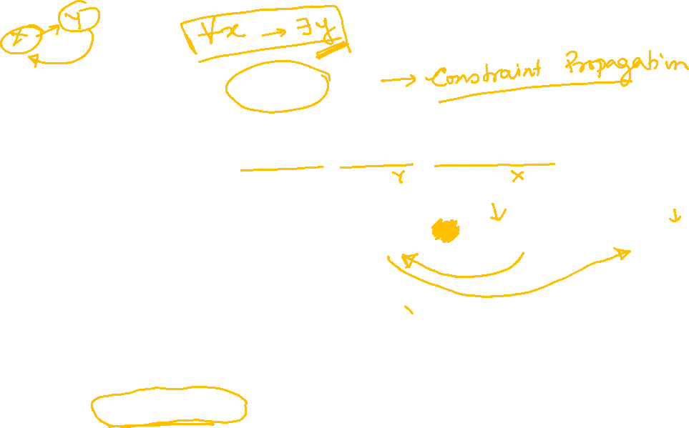
Arc Consistency of CSP
A CSP is consistent iff all the arcs are consistent
WA | NT | Q | NSW | V | SA
If a variable X loses a value, neighbors of X should be rechecked
Arc consistency detects failure before forward checking

Slide 35

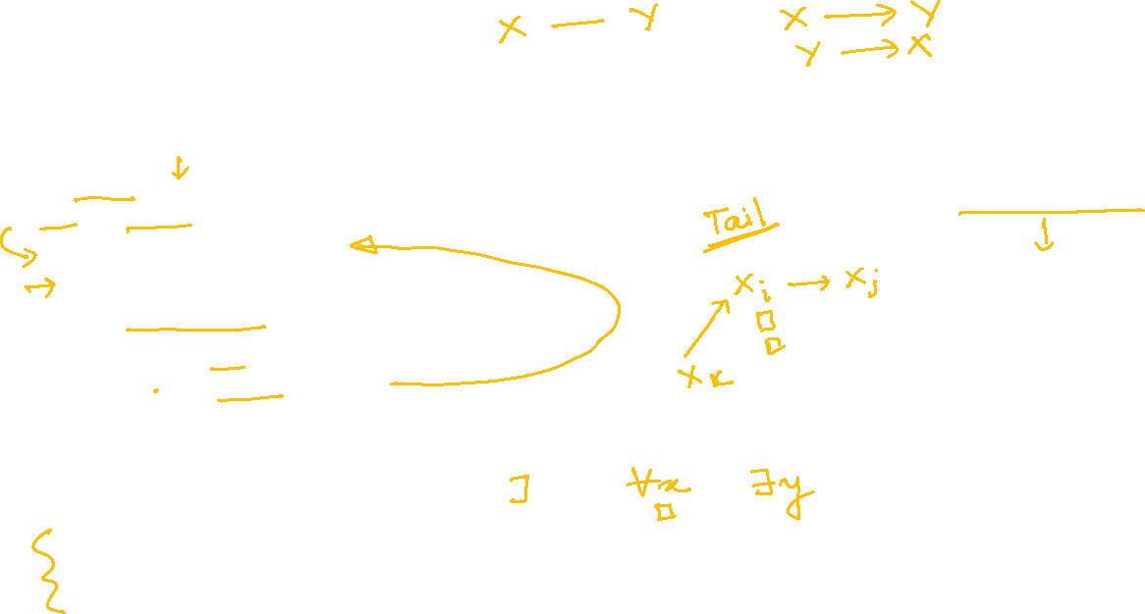
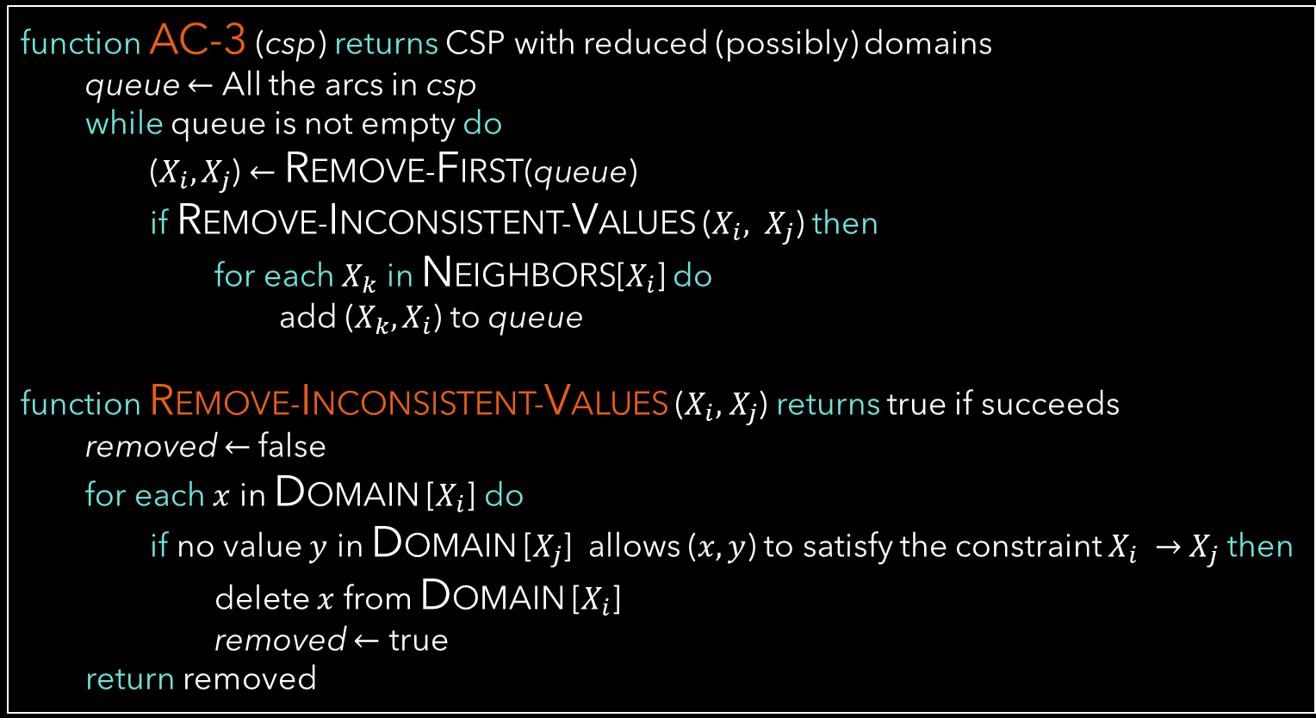
Enforcing Arc Consistency in CSP
function AC-3 (csp) returns CSP with reduced (possibly) domains
queue $←$ All the arcs in csp
while queue is not empty do
($X_{i}, X_{j}$) $←$ REMOVE-FIRST(queue)
if REMOVE-INCONSISTENT-VALUES ($X_{i}, X_{j}$) then
for each $X_{k}$ in NEIGHBORS[$X_{i}$] do
add ($X_{k}, X_{i}$) to queue
function REMOVE-INCONSISTENT-VALUES ($X_{i}, { X}_{j}$) returns true if succeeds
removed $←$false
for each $x$ in DOMAIN [$X_{i}$] do
if no value $y$ in DOMAIN [$X_{j}$] allows ($x,y$) to satisfy the constraint $X_{i} →{ X}_{j}$ then
delete $x$ from DOMAIN [$X_{i}$]
removed $←$ true
return removed
Runtime: $O(n^{2}d^{3})$

Slide 36

Arc Consistency: Limitation
After enforcing arc consistency
Can have one solution left
Can have multiple solution left
Can have no solution left (Unaware)

Slide 37

Ordering: Minimum Remaining Values (MRV)
Choose the variable that has fewest legal values left in its domain
NT
WA
SA
Q
NSW
V
WA | NT | Q | NSW | V | SA
Most Constraint Variable or Fail-Fast ordering

Slide 38
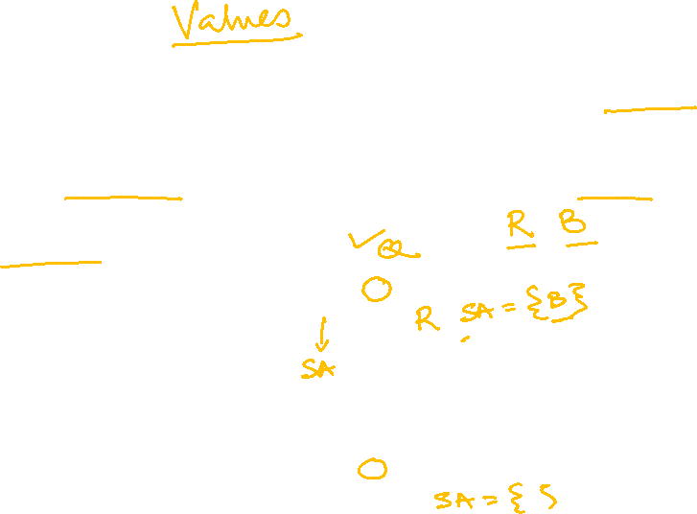
Ordering: Least Constraining Values (LCV)
Choose the value of a variable that rules out the fewest values in the remaining variables
While choosing value for variable Q
“red” is the least constraining variable
Combined ordering can solve upto 1000 queen problem

Slide 39
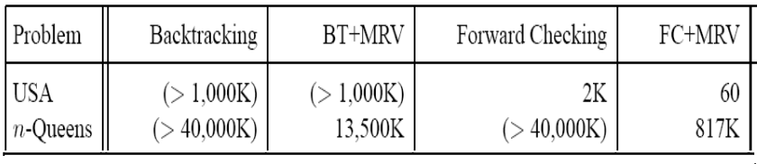

Comparison

Slide 40
CSP: Efficient Solvers

Slide 41
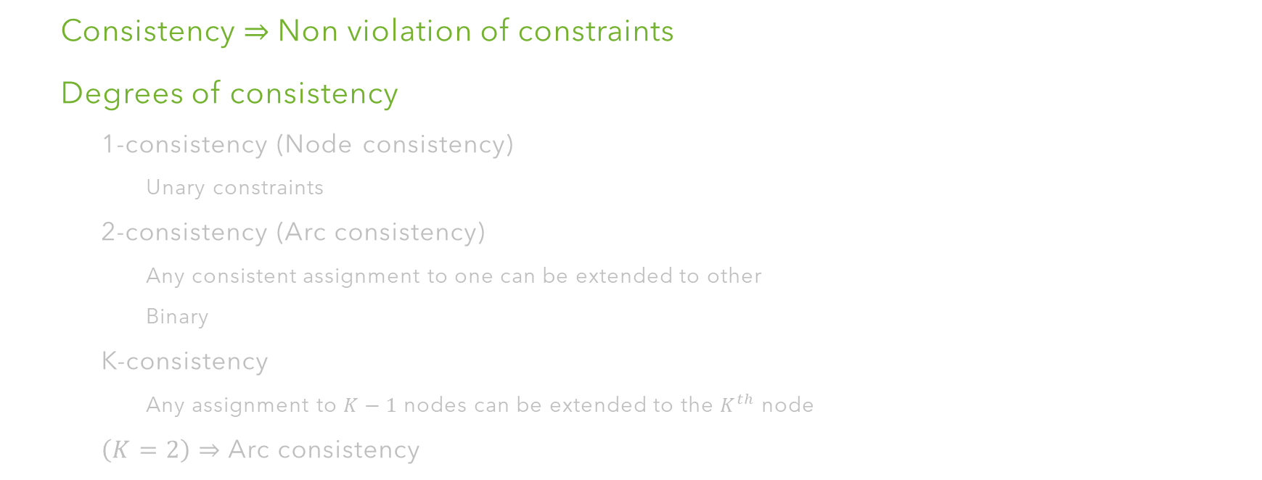

K-Consistency
Consistency $⇒$Non violation of constraints
Degrees of consistency
1-consistency (Node consistency)
Unary constraints
2-consistency (Arc consistency)
Any consistent assignment to one can be extended to other
Binary
K-consistency
Any assignment to $K−1$ nodes can be extended to the $K^{th}$ node
$\left(K=2\right)⇒$ Arc consistency

Slide 42
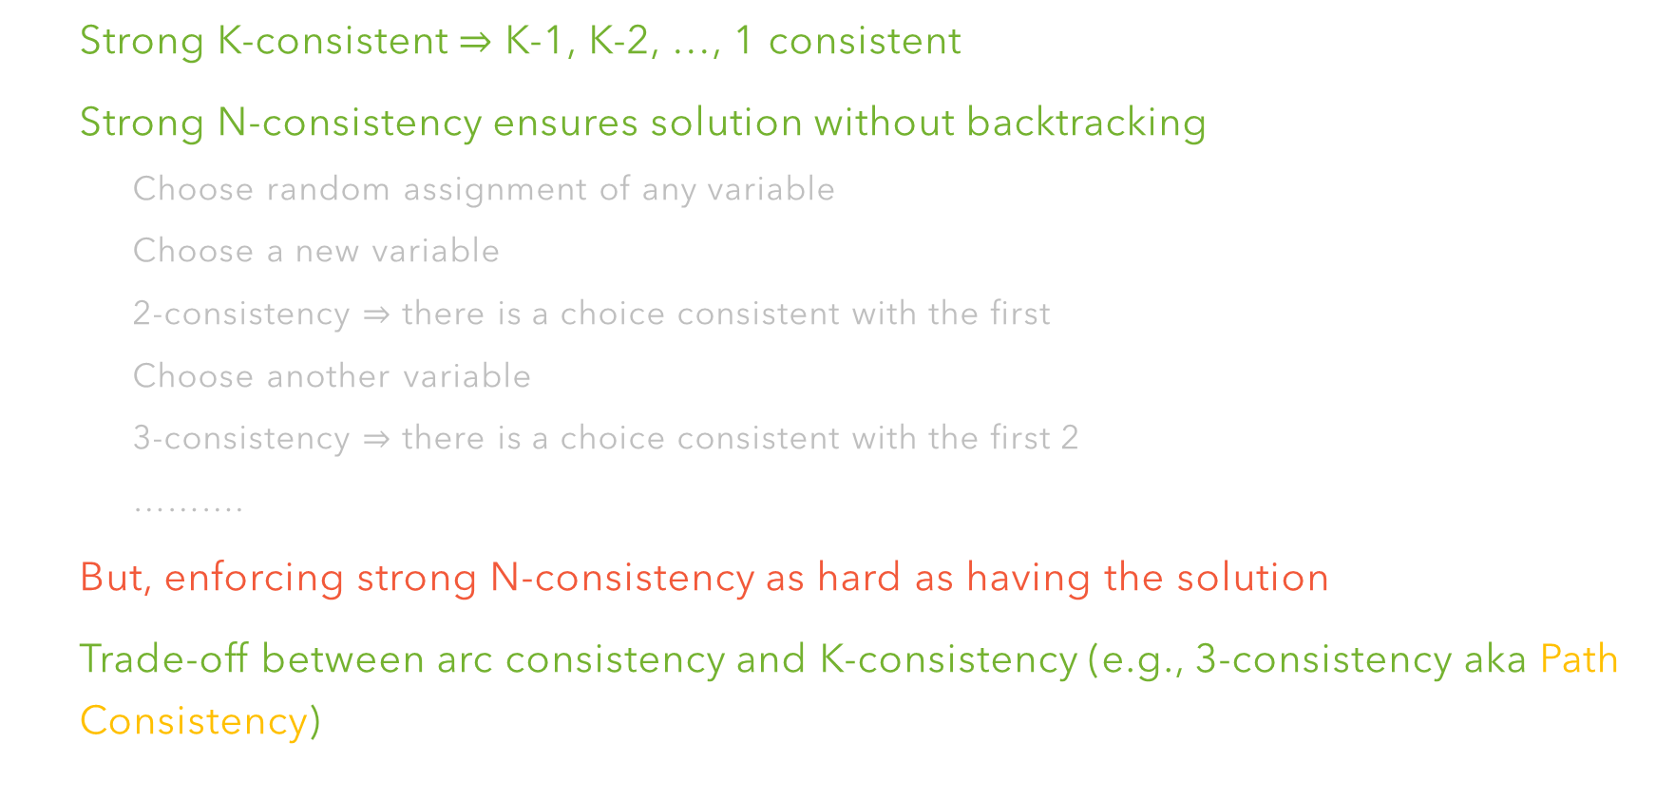

Strong K-Consistency
Strong K-consistent $⇒$ K-1, K-2, …, 1 consistent
Strong N-consistency ensures solution without backtracking
Choose random assignment of any variable
Choose a new variable
2-consistency $⇒$ there is a choice consistent with the first
Choose another variable
3-consistency $⇒$ there is a choice consistent with the first 2
……….
But, enforcing strong N-consistency as hard as having the solution
Trade-off between arc consistency and K-consistency (e.g., 3-consistency aka Path Consistency)

Slide 43
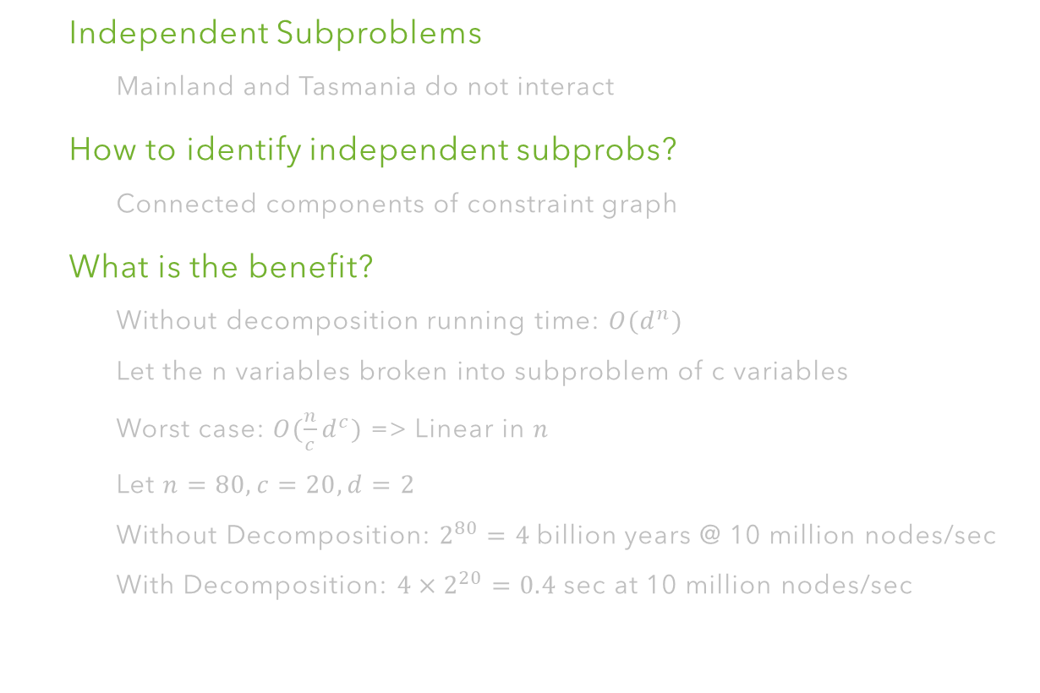
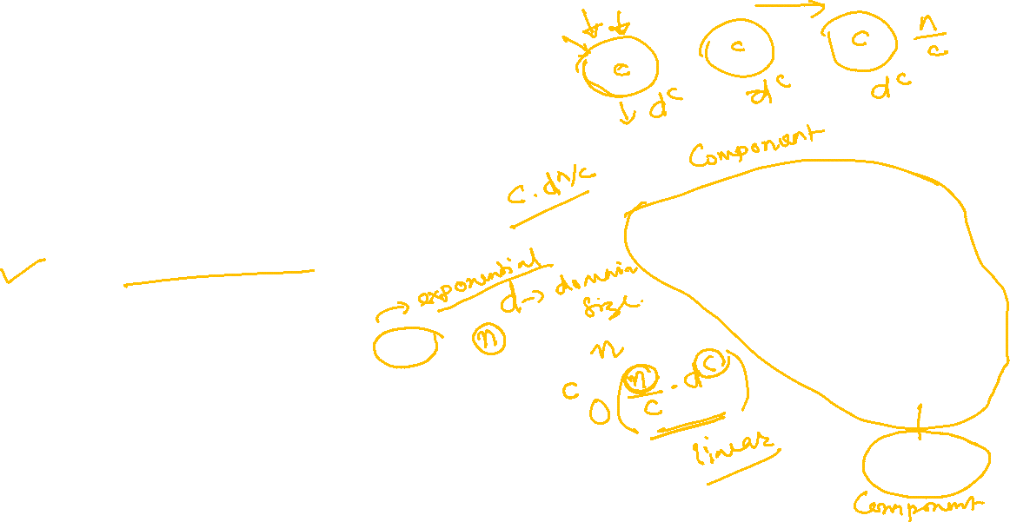
Problem Structure
Independent Subproblems
Mainland and Tasmania do not interact
How to identify independent subprobs?
Connected components of constraint graph
What is the benefit?
Without decomposition running time: $O(d^{n})$
Let the n variables broken into subproblem of c variables
Worst case: $O(\frac{n}{c}d^{c})$ => Linear in $n$
Let $n=80, c=20, d=2$
Without Decomposition: $2^{80}=4$billion years @ 10 million nodes/sec
With Decomposition: ${4×2}^{20}=0.4$ sec at 10 million nodes/sec
NT
Q
WA
SA
NSW
V
T
Very uncommon to find such a problem ☹

Slide 44
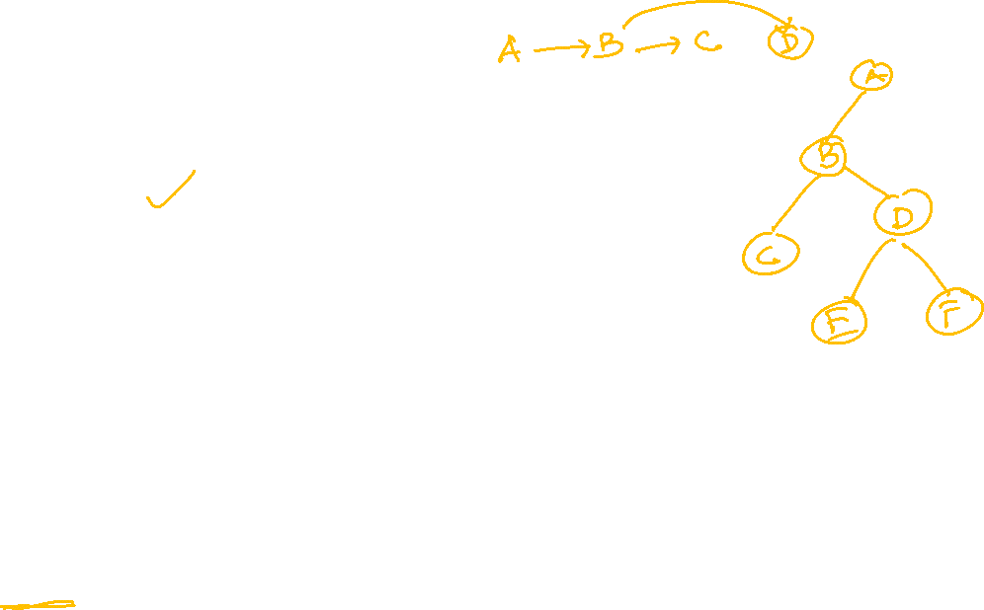
Tree Structured CSP
A
E
B
D
C
F
Theorem: If the constraint graph has no loop (i.e., tree), the CSP can be solved in $O(nd^{2})$ in worst case

Slide 45
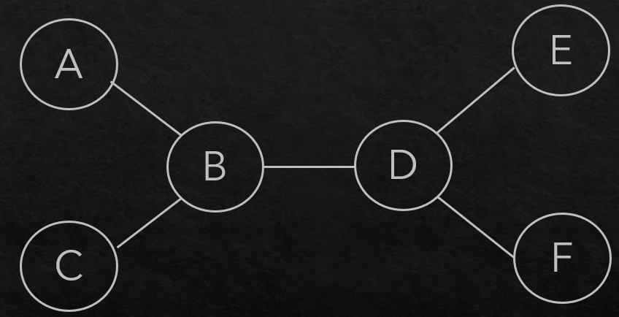
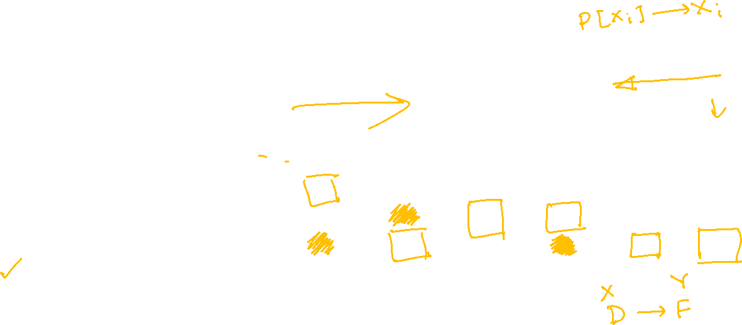
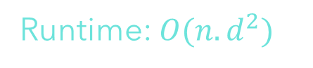
Tree Structured CSP: Algorithm
A
B
C
D
E
F
ORDER: Choose a root variable and order the other variables in such a way that parents precede children
REMOVE-BACKWARD: For i=n to 2, RemoveInconsistent(Parent[$X_{i}$], $X_{i}$)
ASSIGN-FORWARD: For i=1 to n, assign $X_{i}$ consistently with Parent[$X_{i}$]
Runtime: $O(n.d^{2})$

Slide 46
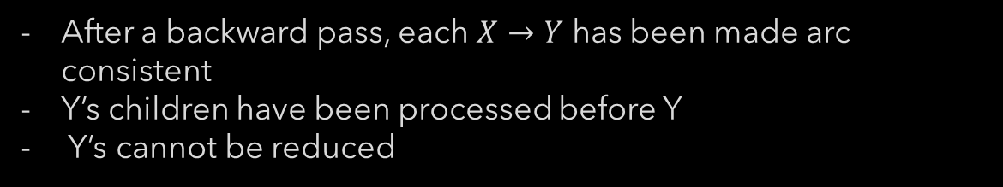
Tree Structured CSP: Algorithm
A
B
C
D
E
F
After backward pass all the root-to-leaf arcs are consistent
After a backward pass, each $X→Y$ has been made arc consistent
Y’s children have been processed before Y
Y’s cannot be reduced
Forward assignment will not backtrack
Does not work on constraint graphs with cycles. WHY?
Tree structured CSPs are not common either ☹

Slide 47
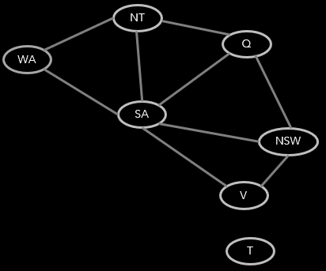
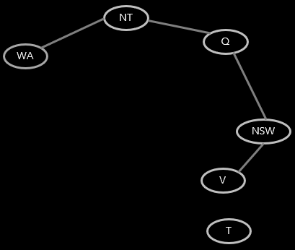

Convert to Tree Structured CSP
CONDITIONING: Forcefully instantiate a variable and prune the domains of the neighbors
CUTSET-CONDITIONING: Obtain a cutset of variables, removing those will leave the concept graph a tree. Instantiate (in all ways) the cutset.

Slide 48


Cutset Conditioning
Choose a cutset
Instantiate cutset
Compute residual
Solve residual Tree CSP
Runtime with cutset size c = $O(d^{c}.\left(n−c\right).d^{2})$

Slide 49













Tree Decomposition
NT
Q
WA
SA
NSW
V
M1
M2
M3
M4
$$≠$$
NT
$$≠$$
Q
Q
$$≠$$
NSW
Q
$$≠$$
NSW
WA
NT
agree on common var
agree on common var
agree on common var
$$≠$$
$$≠$$
$$≠$$
$$≠$$
$$≠$$
$$≠$$
$$≠$$
$$≠$$
SA
SA
SA
SA
{(WA=r, NT=g, SA=b),
(WA=b, NT=r, SA=g),
………………….}
Agree: (M1,M2) $∈$ {((WA=g, NT=g, SA=g), (NT=g, Q=b, SA=g)), ……………..}

Slide 50


Iterative Improvement
Start with a complete assignment with unsatisfied constraints
Iteratively change solution
Reassign variable values
No data structure like stack be maintained
Algorithm
Variable selection: randomly select any conflicting variable
Value selection: min-conflict heuristics
Choose a value that violates the fewest constraints
(hill climb with h(n)=total number of constraints violated)
$$≠$$
$$≠$$

Slide 51






4-Queen Problem
$$h=5$$
$$h=2$$
$$h=0$$

Slide 52


Min Conflict Heuristics
4
4
1
1
1
1
1
1
4
3
0
3
2
2
2
0
4
4
3
4
3
2
2
1
0
1
4
3
2

Slide 53

Min Conflict Heuristics
1
0
0
0
0
0
2
2
0
2
1
2
0
0
0
0
0
1
0
0

Slide 54



Min Conflict Heuristics
Can solve n-queen problem for arbitrary n (~10,000,000) with high probability in constant time
Similar performance on random CSPs except for a narrow range:
$$R= \frac{|Constraint set|}{|Variable set|}$$

Slide 55

Comparison

Slide 56
Summary
CSP: Special instance of search problem
Generic (i.e., problem agnostic)
Basic algorithm: Backtracking
Speedup: Ordering, Filtering, Problem structure
Iterative min-conflict (More Practical)

